Slide 1
Working diagram and data sources
Nutrient diversity in the food system
Sold diversity
System diversity
Catch diversity
Consumption diversity
Nutrient diversity in household diets
Biomonitoring data
CFR-level
Catch and consumption monitoring data
Household-level
Nutrient database
Species-level

Slide 2
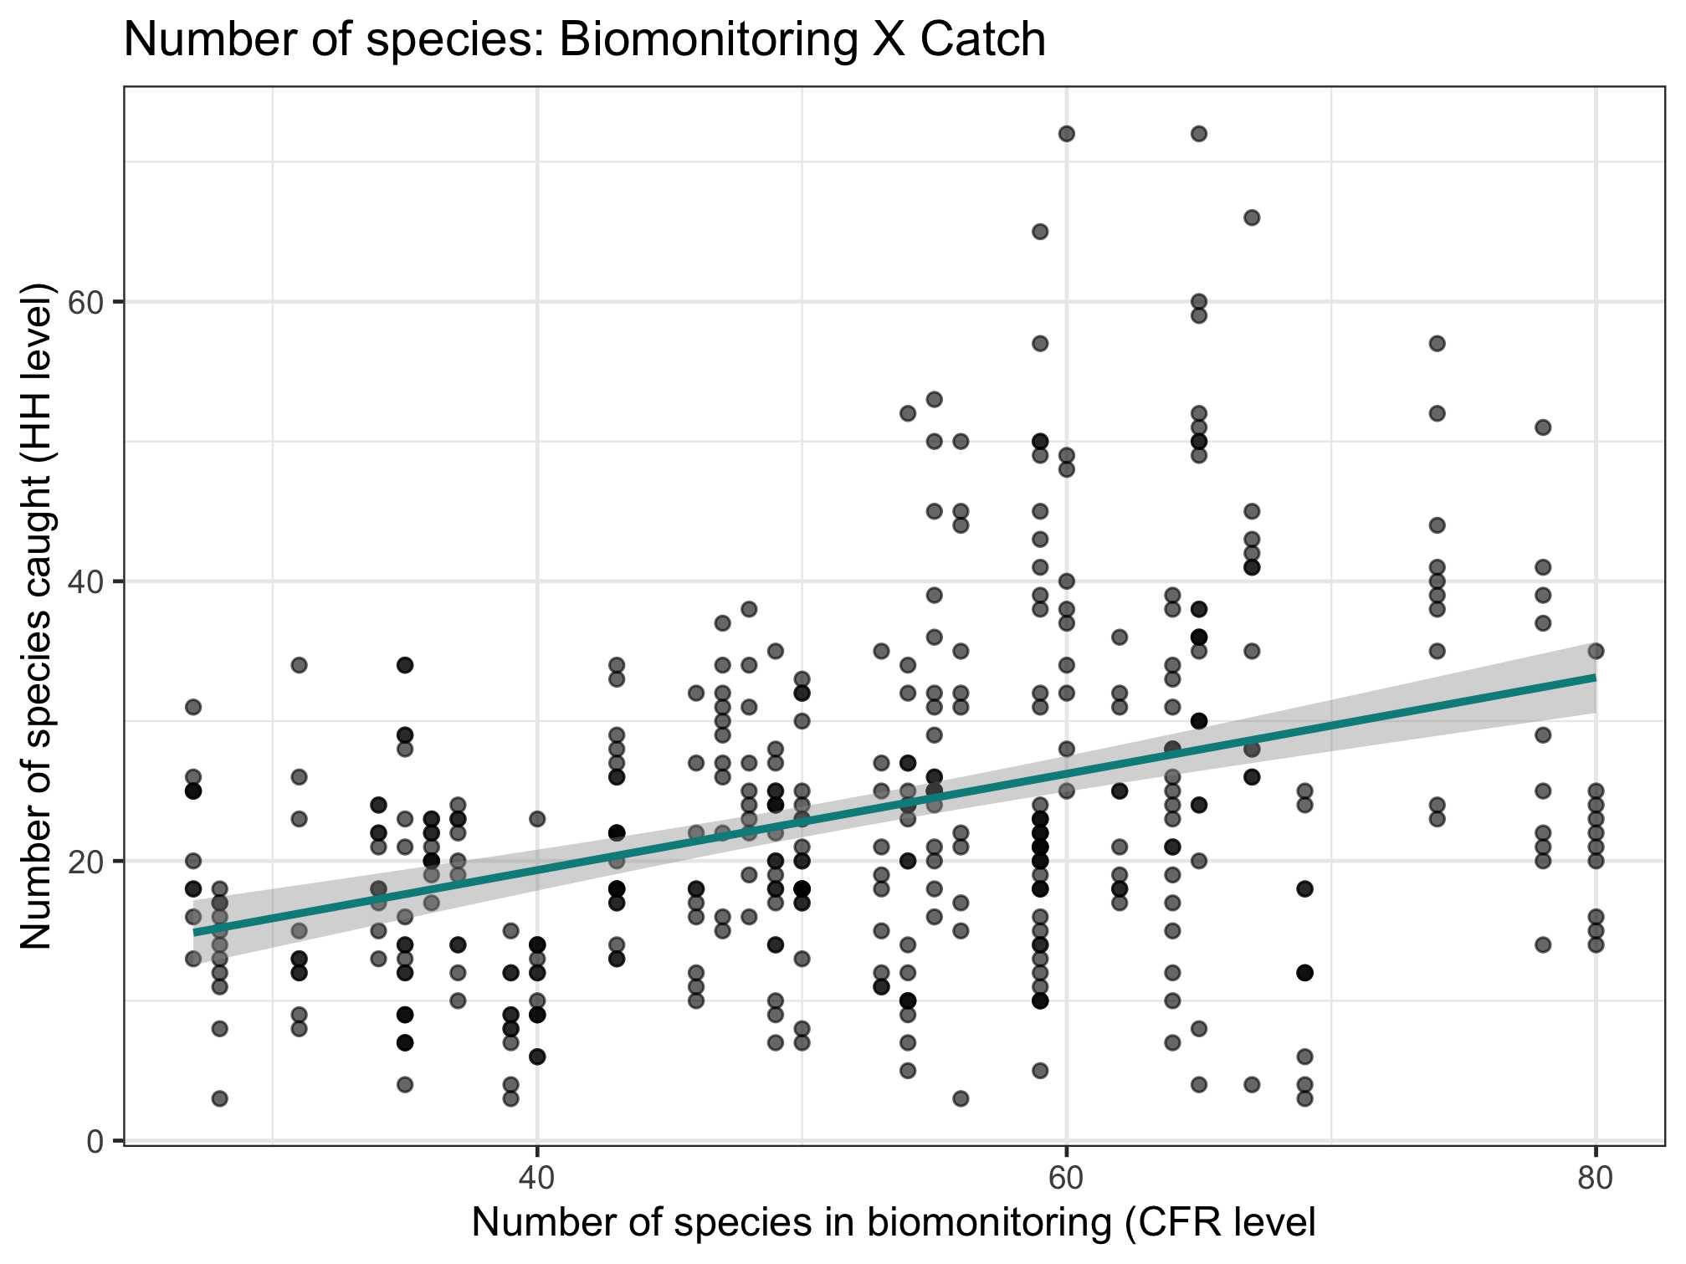
Nutrient diversity in the food system
Sold diversity
Slope = 0.384
System diversity
Catch diversity
Consumption diversity
Nutrient diversity in household diets

Slide 3
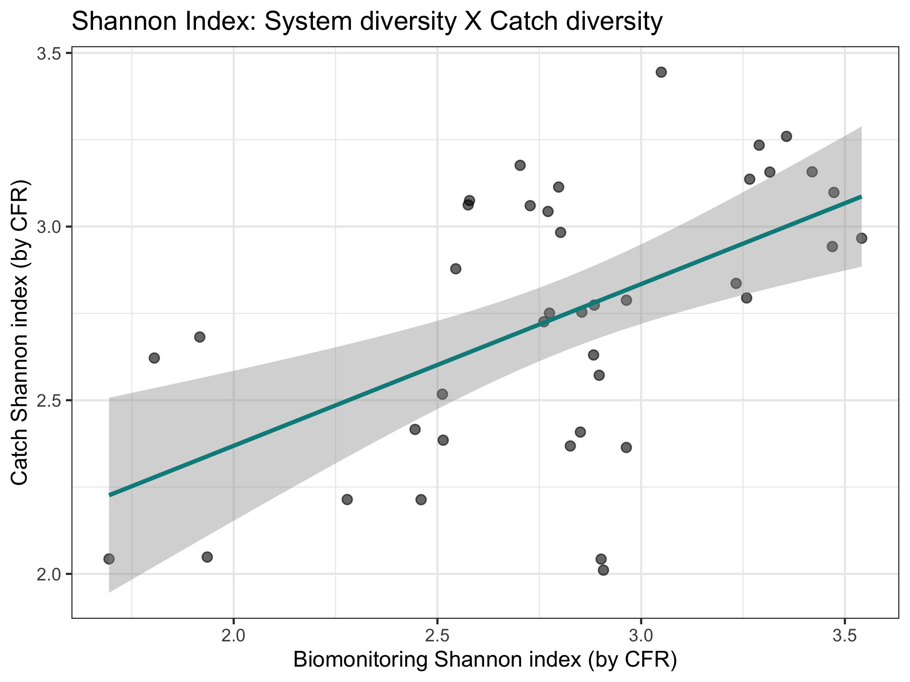
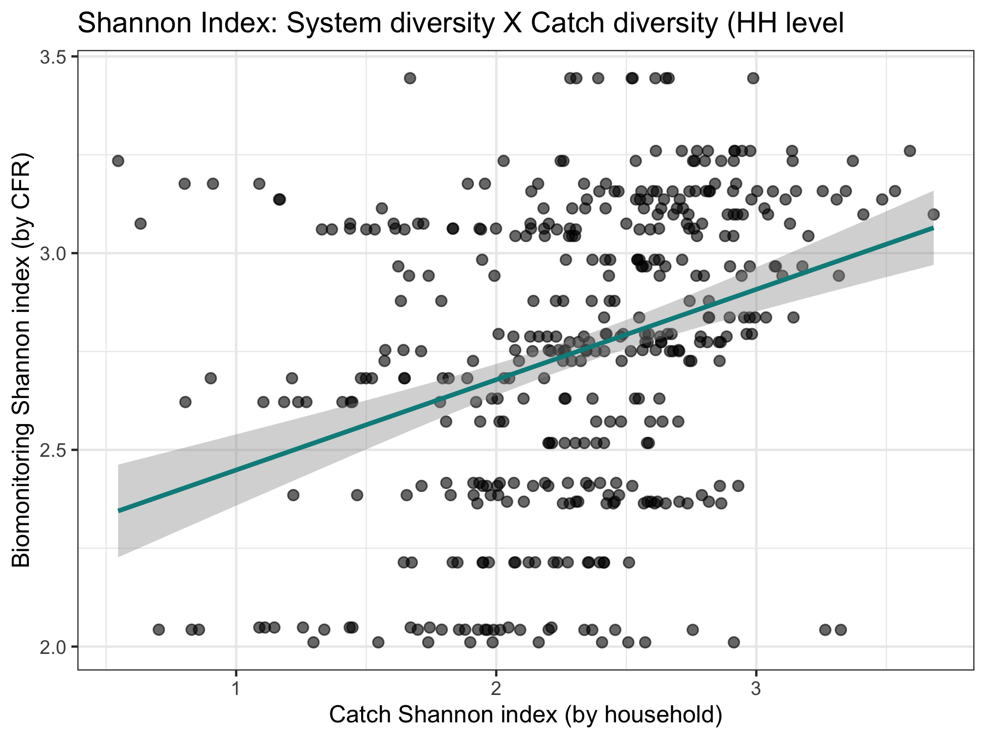
Color code by CFR type, maybe CFR size
Nutrient diversity in the food system
Sold diversity
Slope = 0.486
System diversity
Catch diversity
Consumption diversity
Nutrient diversity in household diets
Slope = 0.376

Slide 4
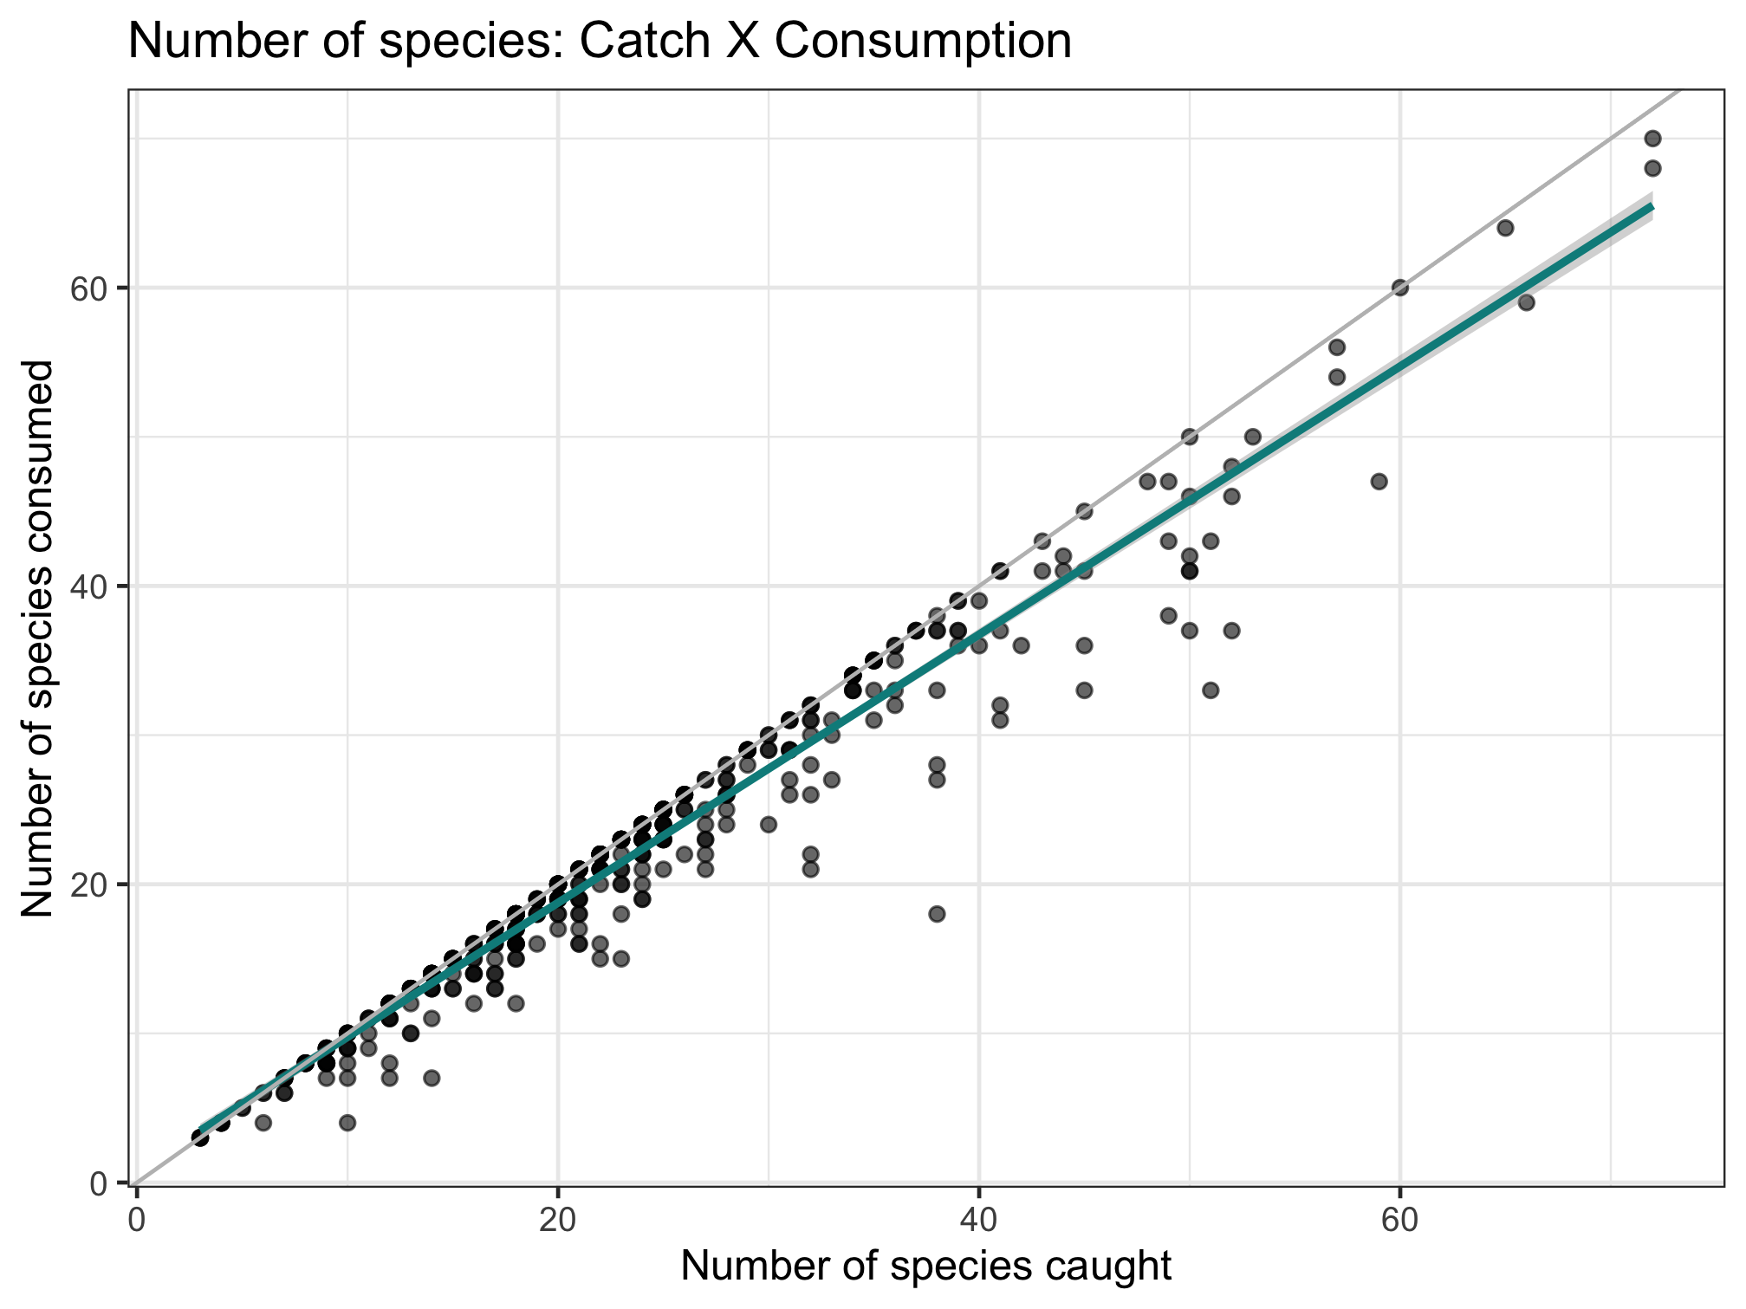
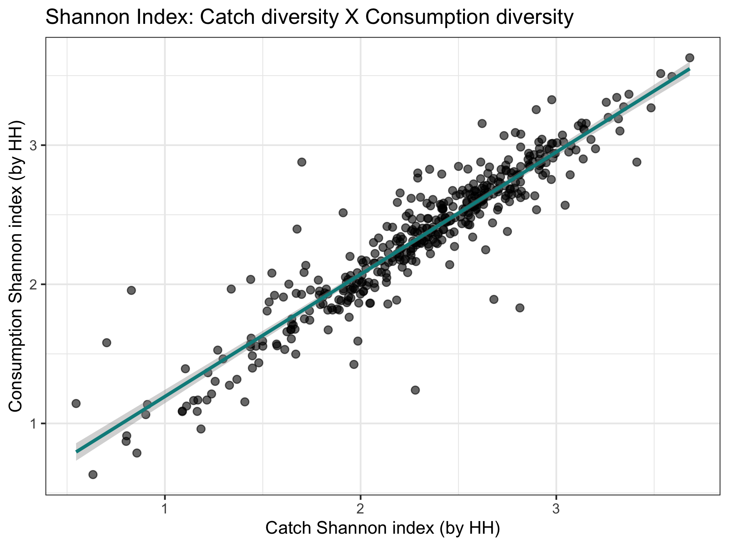
Nutrient diversity in the food system
Sold diversity
Slope = 0.979
System diversity
Catch diversity
Consumption diversity
Nutrient diversity in household diets
Slope = 0.924

Slide 5
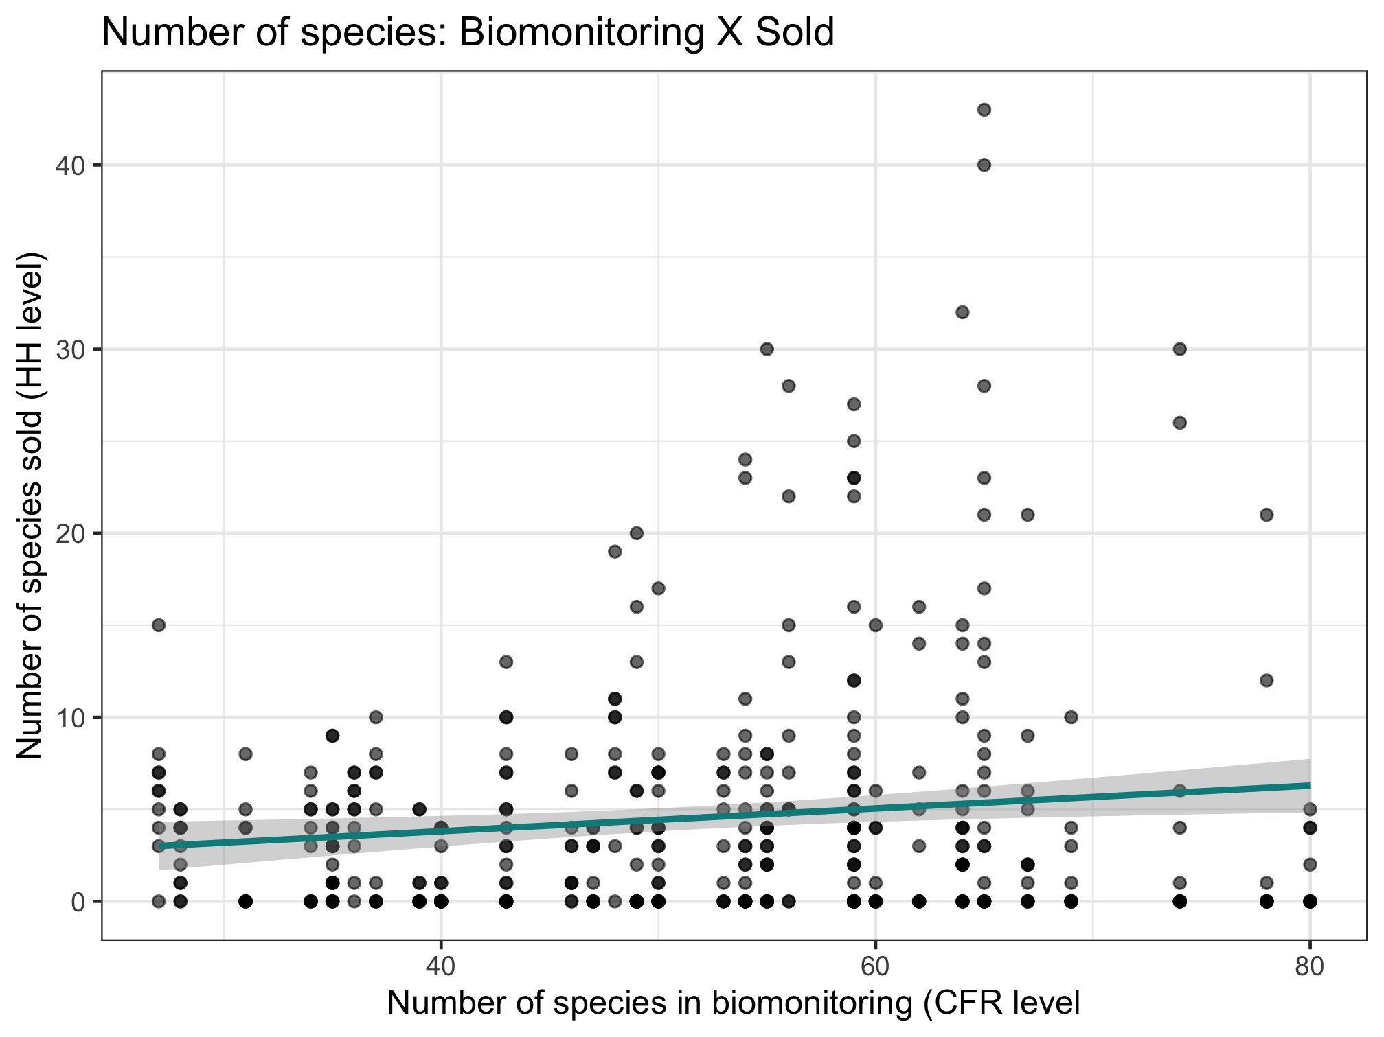
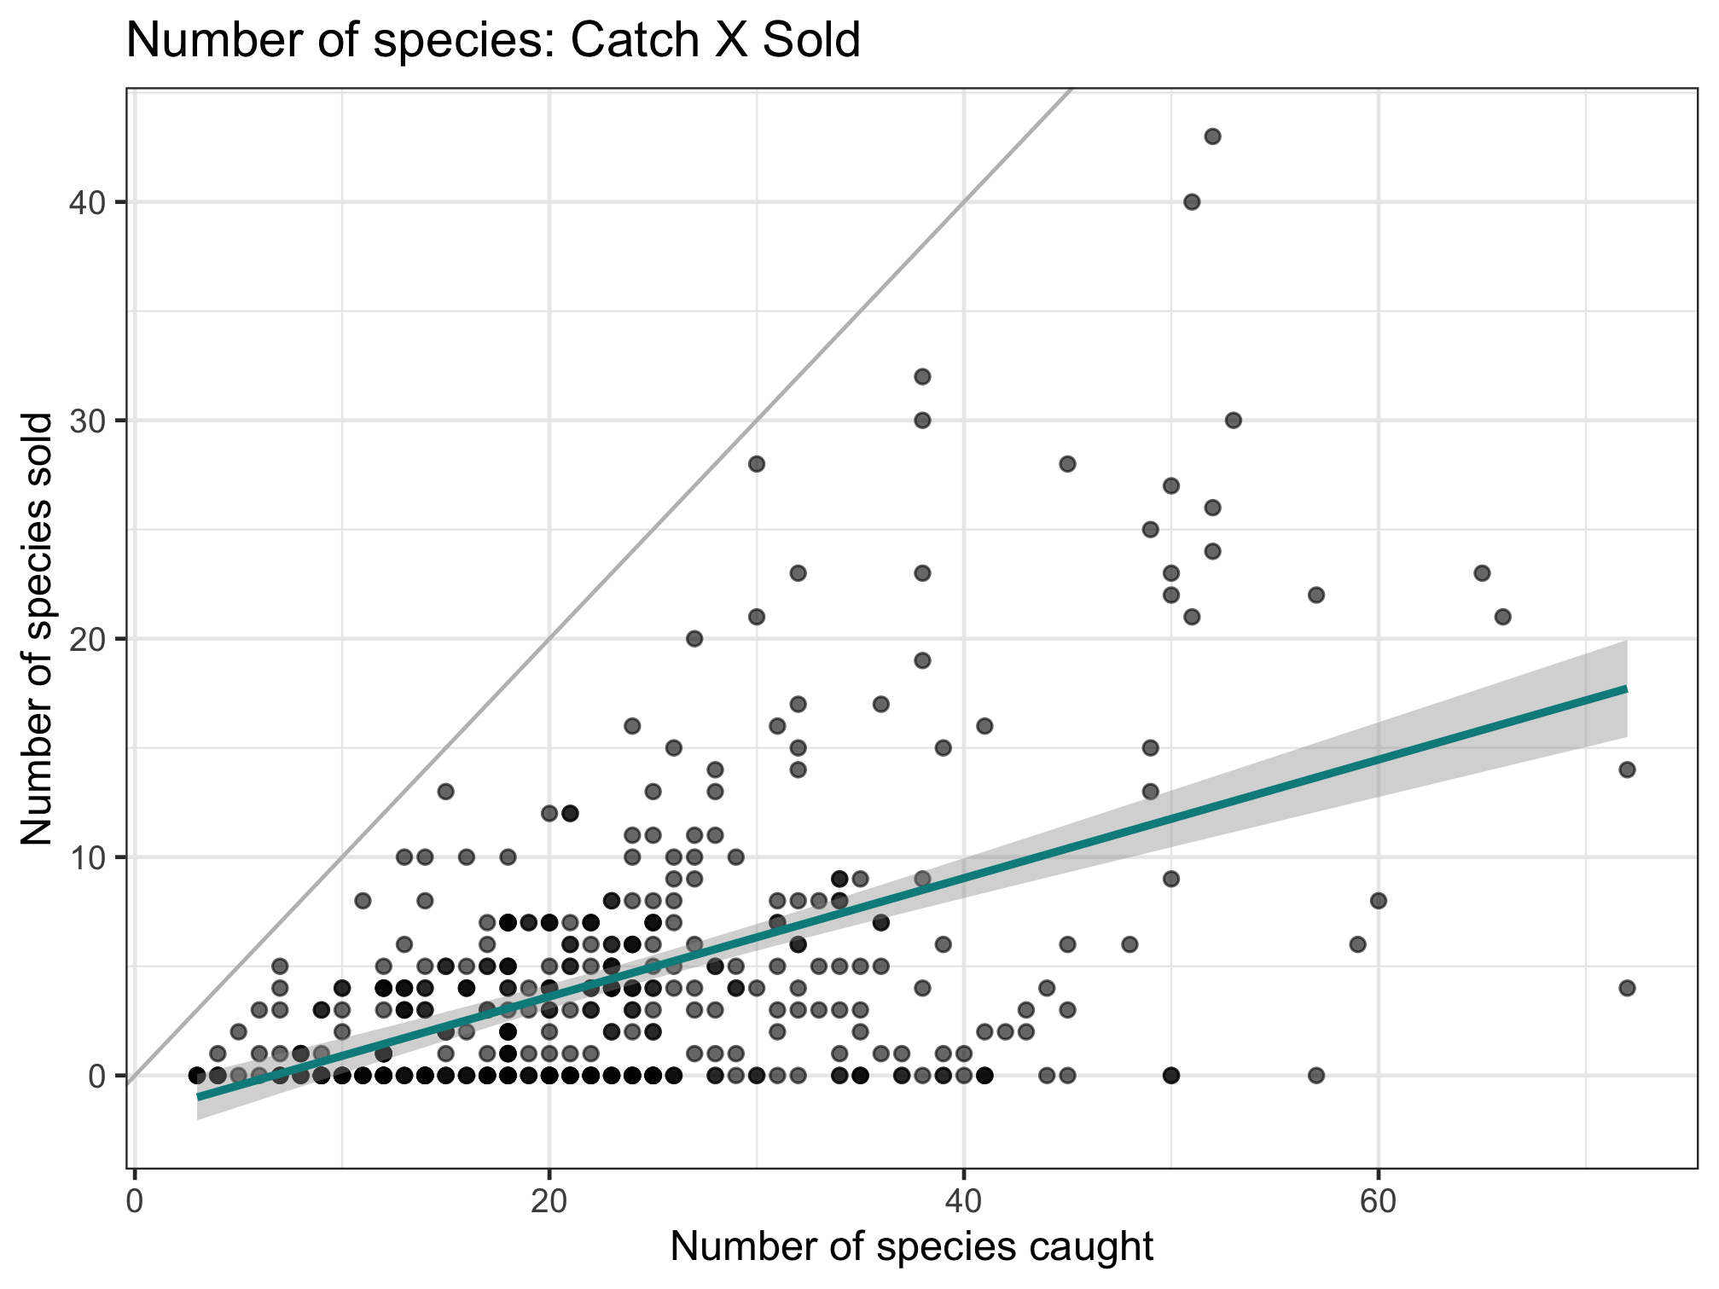
Nutrient diversity in the food system
Sold diversity
System diversity
Catch diversity
Consumption diversity
Nutrient diversity in household diets
Slope = 0.397

Slide 6
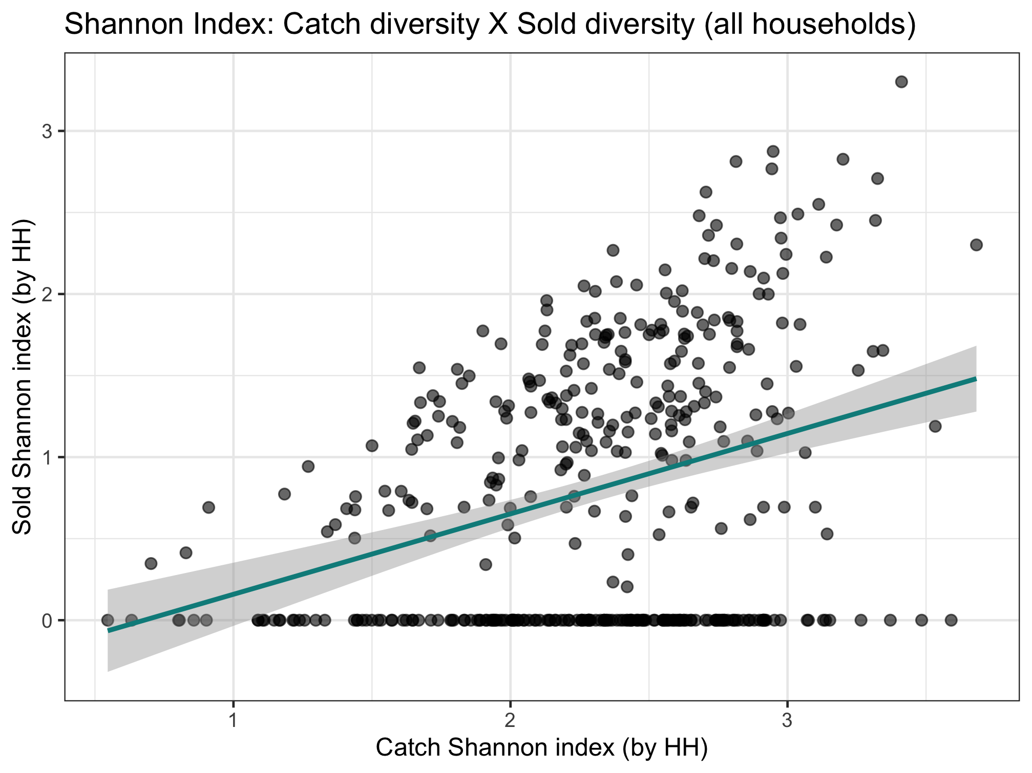
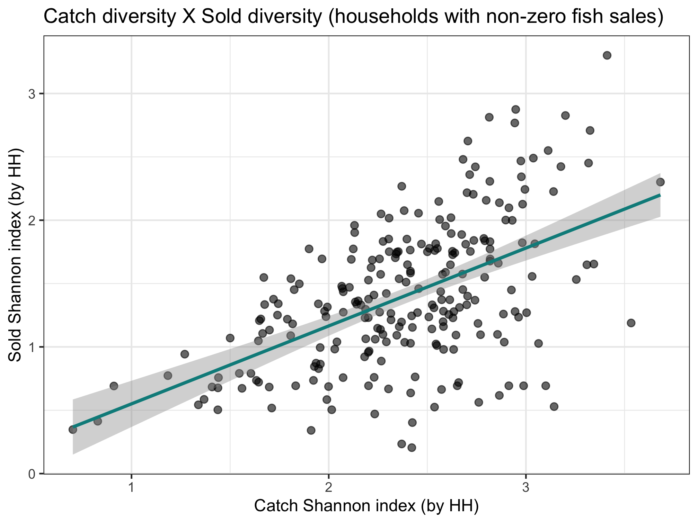
Key point:
Sold species are selective.
Catch and consumption are in lock step. Much accounting includes only sold, which isn't as linked to what is in the ecosystem. Disprefered sale species are underrecognizedl
Nutrient diversity in the food system
Sold diversity
Slope = 0.287
System diversity
Catch diversity
Consumption diversity
Nutrient diversity in household diets
Slope = 0.493

Slide 7
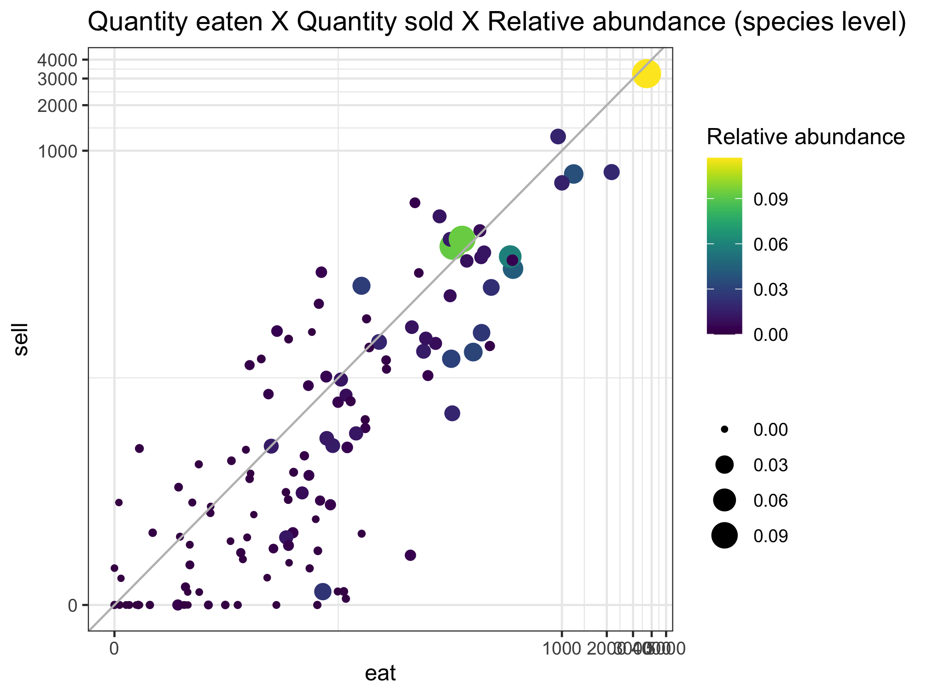
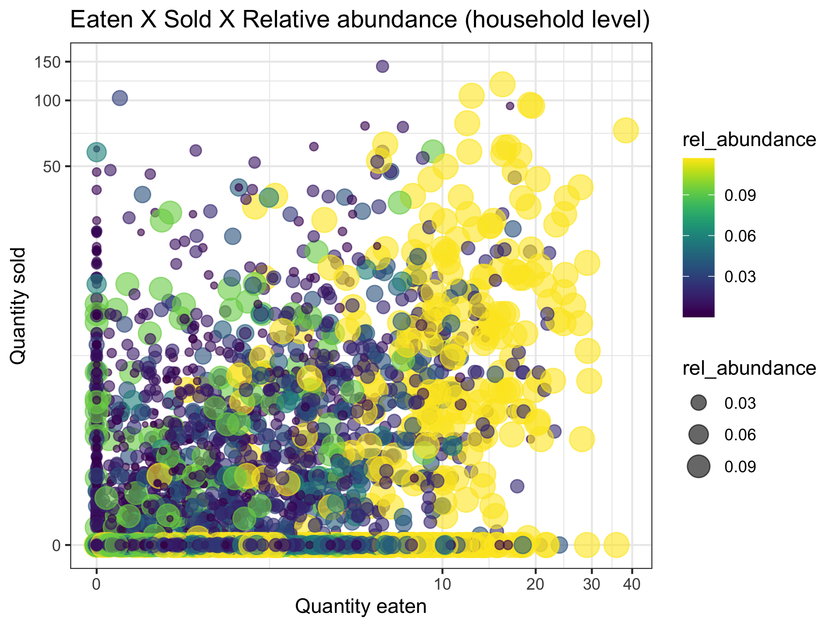
This uses relative abundance at the system level.
Nutrient diversity in the food system
Sold diversity
System diversity
Catch diversity
Consumption diversity
Nutrient diversity in household diets
Make relative abundance at the CFR for this figure.
Conclusion: abundance doesn’t necessarily drive sale or consumption

Slide 8
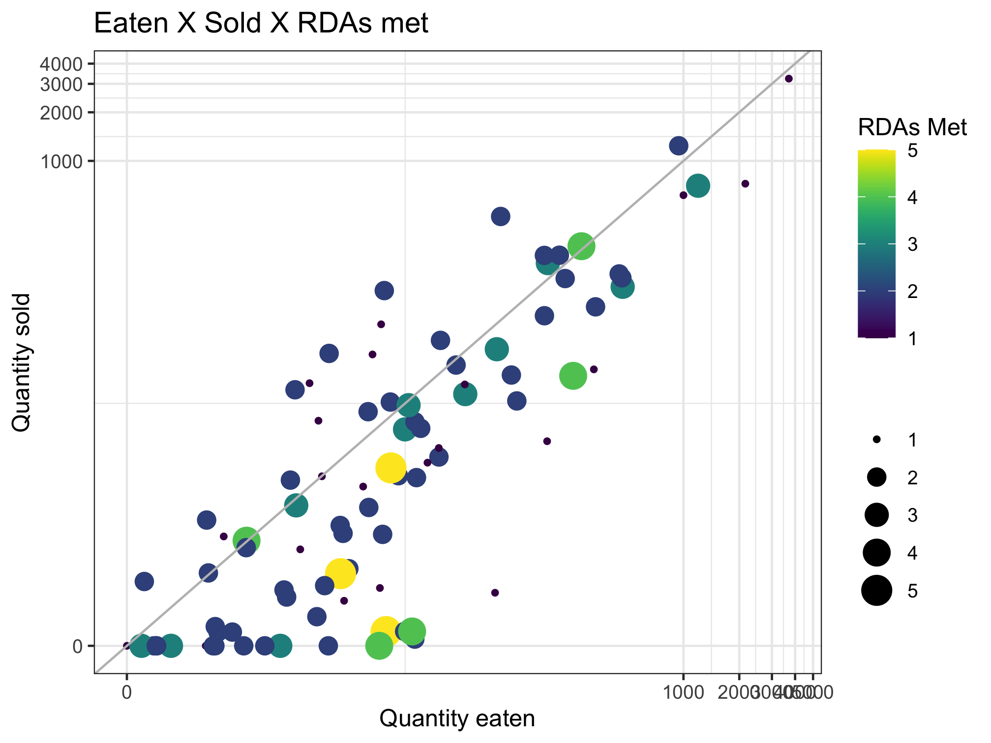
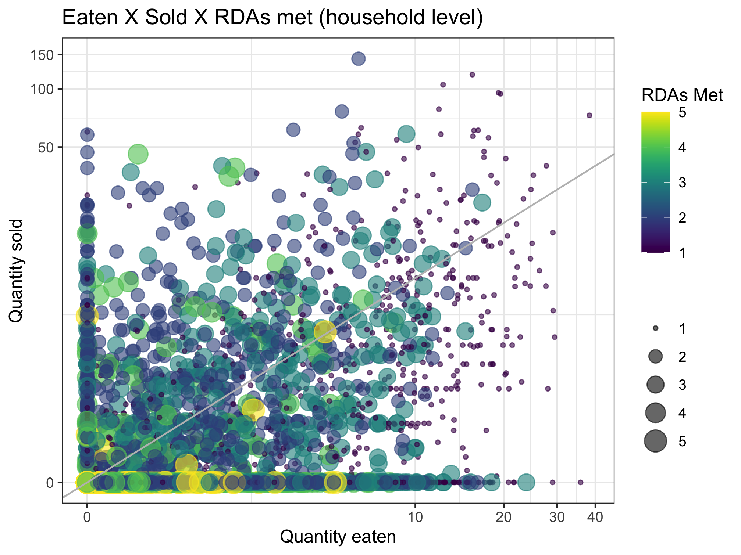
Nutrient diversity in the food system
Sold diversity
System diversity
Catch diversity
Consumption diversity
Nutrient diversity in household diets
Is this a small fish effect?
Yellow means whatever the last nutrient is (VitA or calcium (small fish)
Order data frame so most nutritious species are on top

Slide 9
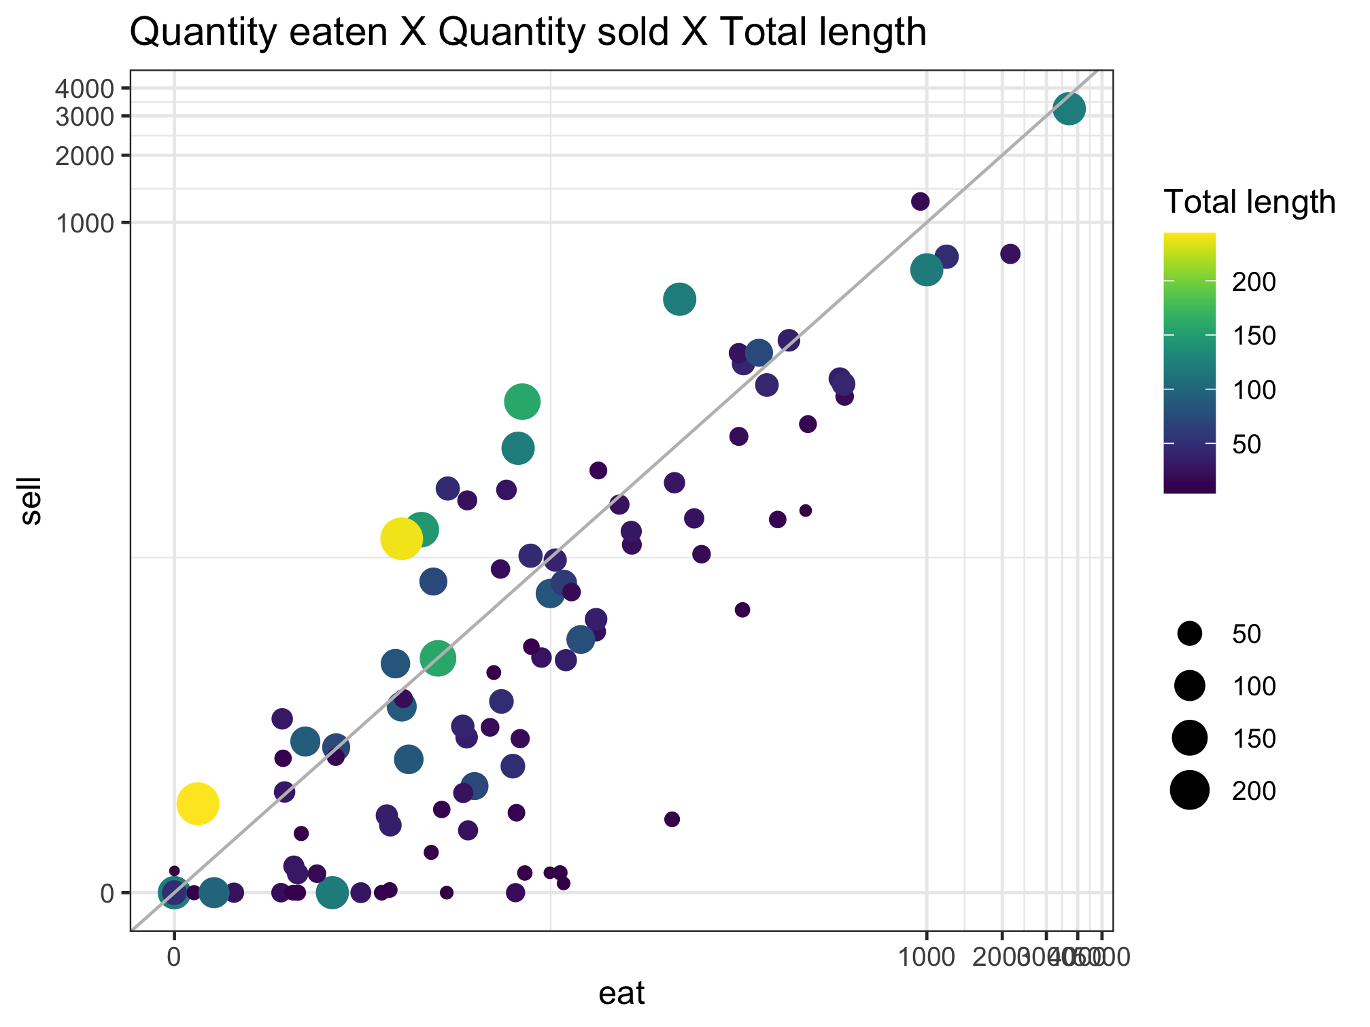
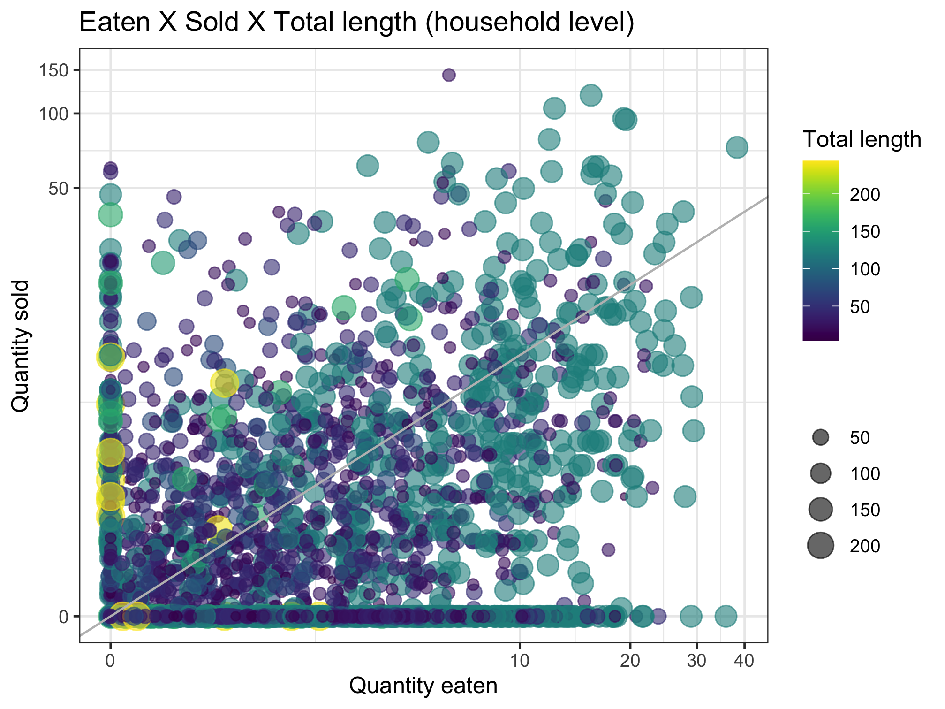
Nutrient diversity in the food system
Sold diversity
System diversity
Catch diversity
Consumption diversity
Nutrient diversity in household diets

Slide 10
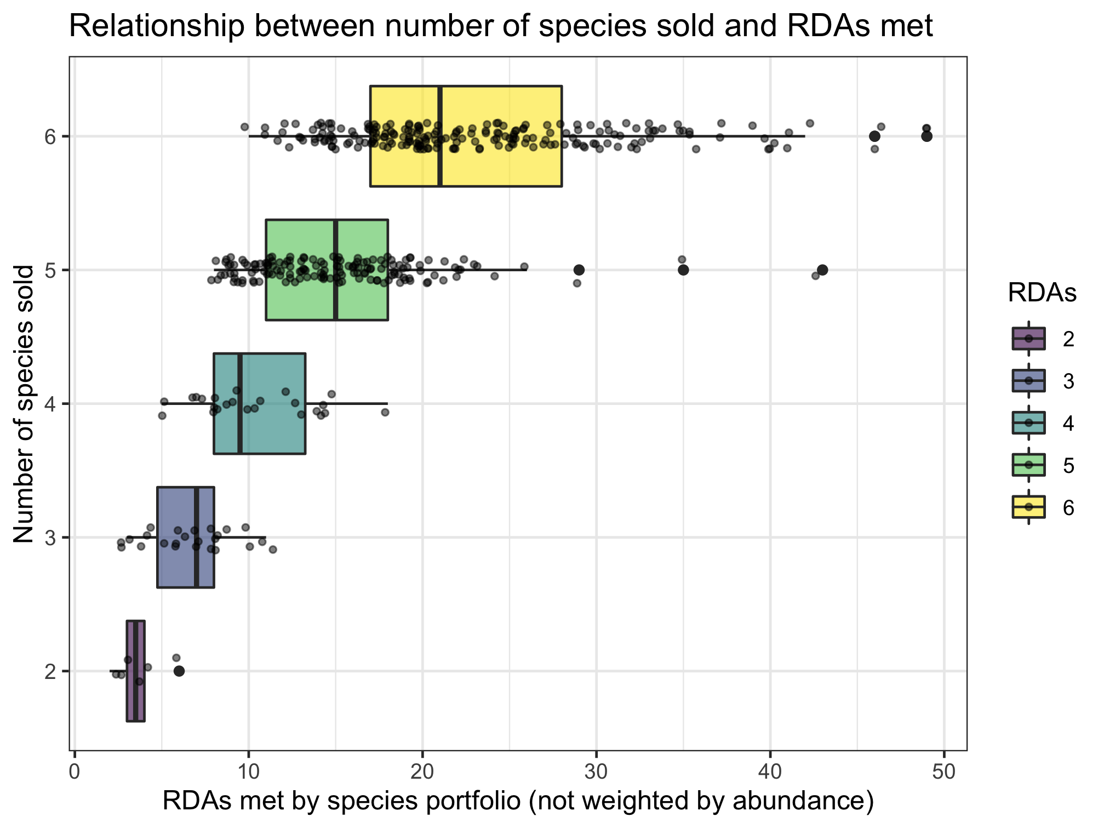
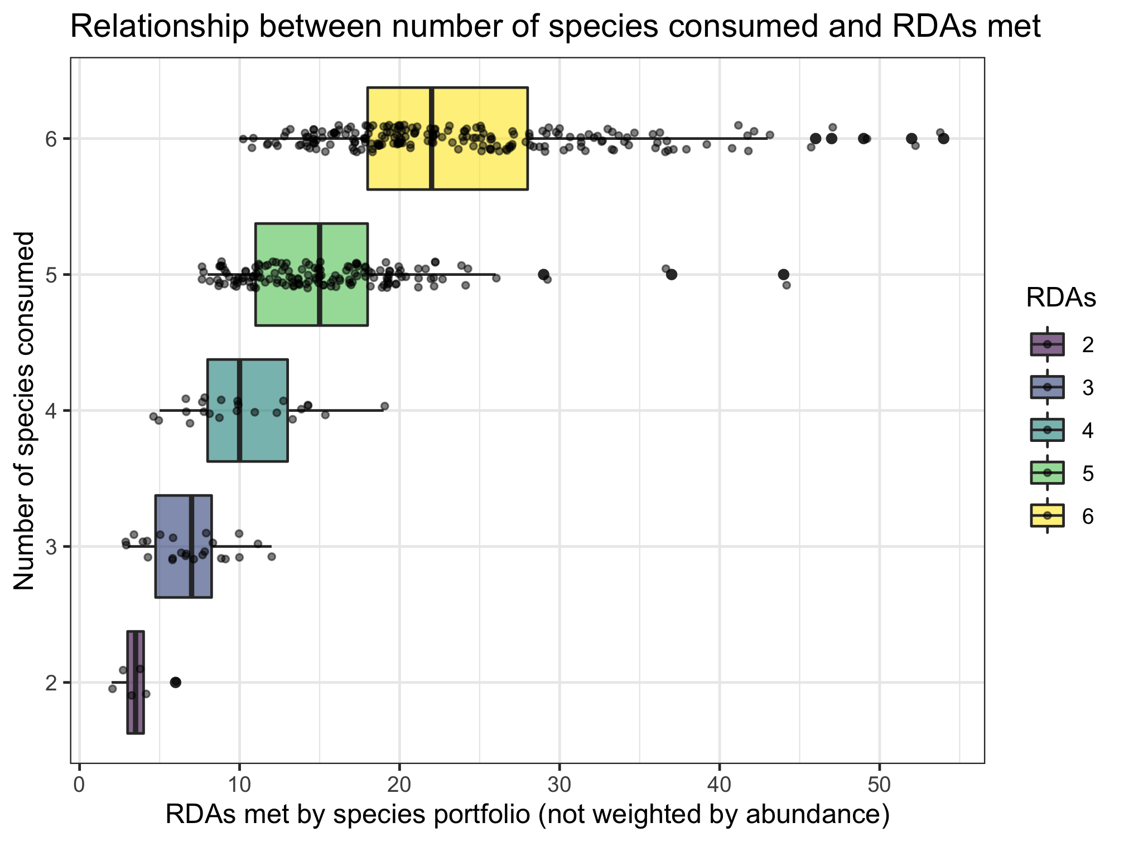
Nutrient diversity in the food system
Sold diversity
System diversity
Catch diversity
Consumption diversity
Nutrient diversity in household diets
Slopes if RDAs treated as continuous:
0.701 (sold)
0.697 (consumed)

Slide 11
Sebastian’s thoughts 20220929
Nestedness is a method
Filtering is a process
Framing should be around filtering, with nestedness as a tool that we might use to understand it
“Community assembly to understand the filters that apply from fish available in the environment to fish available on people’s plates”

